Slide 1
Classification Accuracy and Time Complexity for Classification Models on CIFAR-10
STAT 654
Spring 2020
Quentarius Moore Rohit Sonje Adaiyibo Kio Deep Patel Pooja Phadke

Slide 2
Outline
Dimensionality Reduction
Traditional Methods
Histogram of Gradients (HOG)
Traditional Methods with HOG
Convolutional Neural Network
VGG16 Pre-trained Neural Network
Results
Conclusion

Slide 3
Project Description
Our goals for this project were:
Image analysis using Histogram of Gradients (HOG) for feature extraction.
Comparison of classification accuracy and time complexity of various machine learning algorithms such as logistic regression, SVM, and Naive Bayes when combined with HOG.
Use of deep learning algorithms such as Convolutional Neural Network(CNN) and pre trained networks such as VGG for image classification.
Comparison of classification accuracy and time complexity of (2) and (3) above.

Slide 4
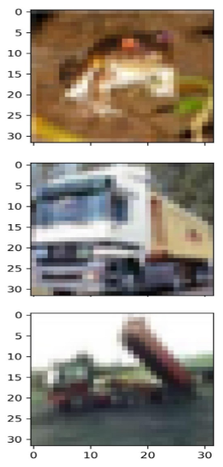
Dataset
CIFAR 10 dataset
Training data: 50000, 32x32 color images classified into 10 classes, 5000 images per class. Classes were a variety of items such as ships, birds, trucks, etc
Test data: 10000, 32x32 color images
Validation data: Training data was split into ‘training’ and validations sets, with 35000 images for training and 15000 for validation
The classes are disjoint meaning the objects do not overlap in the images.

Slide 5
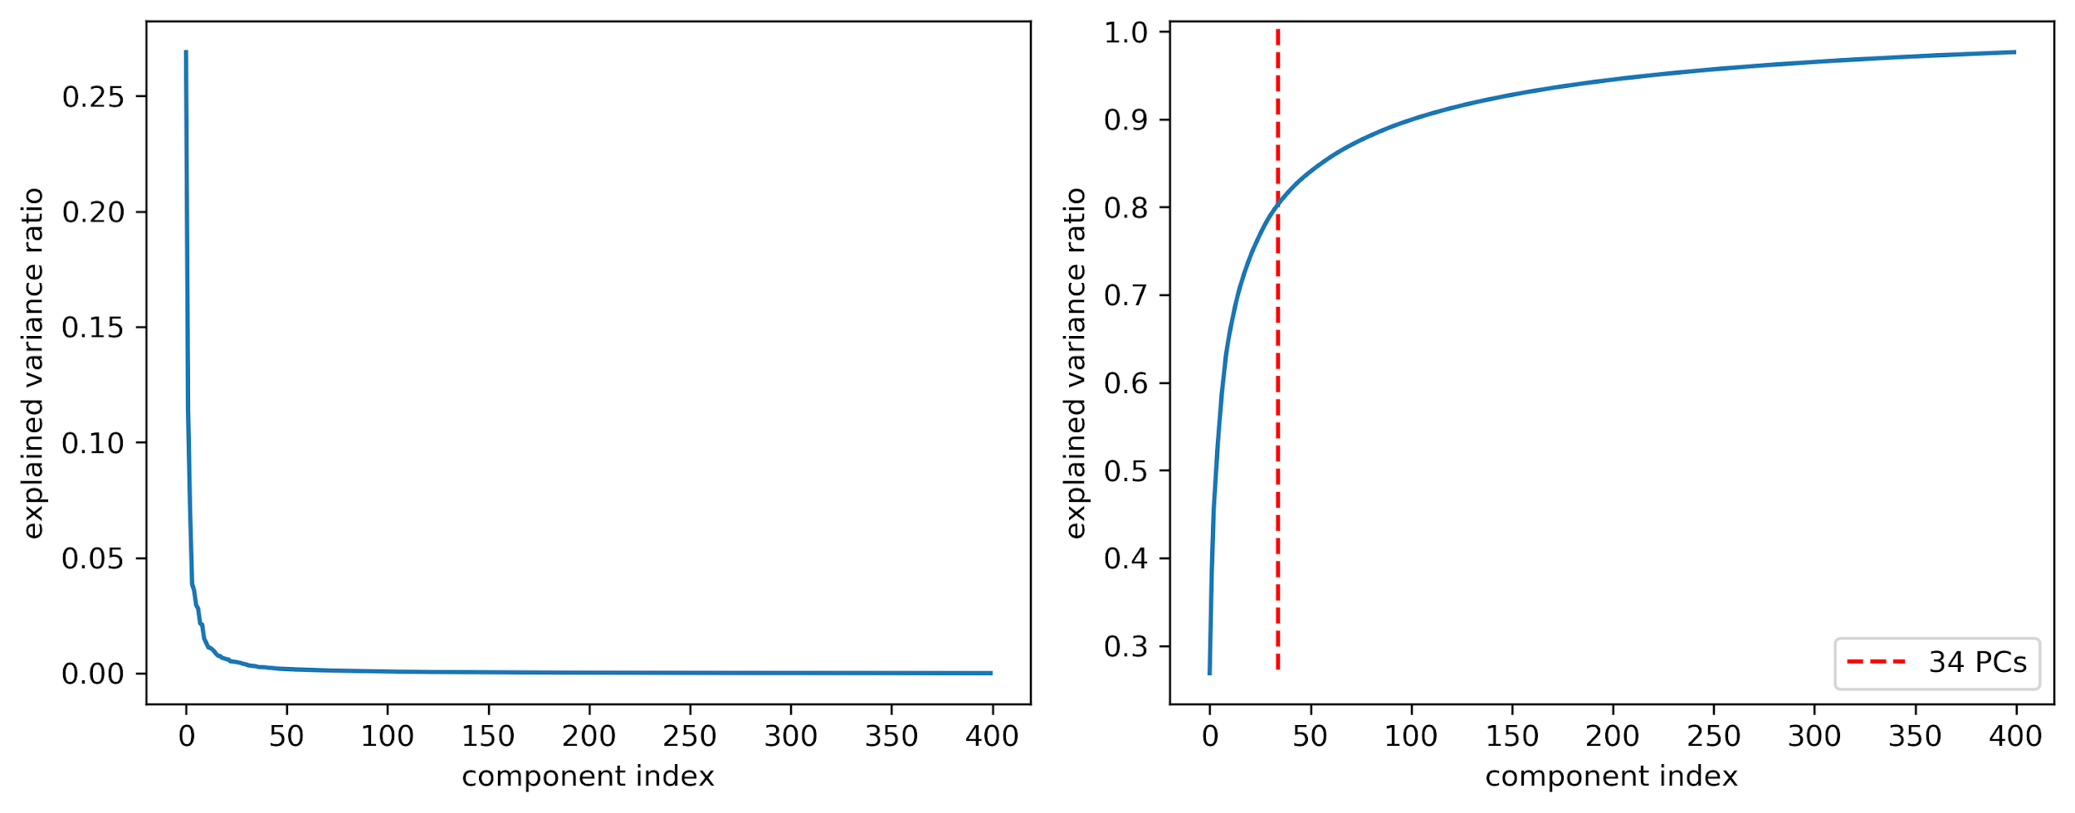
Dimensionality Reduction
Principal Component Analysis
Linear Discriminant Analysis
Select 34 Principal Components (80% of dataset variance explained)

Slide 6
Traditional Methods
Naive Bayes
KNN
Logistic Regression
Random Forest
Gradient Boosting
Support Vector Machines
Voting Classifier*

Slide 7
Traditional - Metrics
Model | Accuracy | Precision | Recall | F1 Score | Time (s)
Naive Bayes | 0.37 | 0.37 | 0.37 | 0.36 | 0.02
KNN | 0.39 | 0.41 | 0.39 | 0.39 | 0.17
Logistic Regression | 0.37 | 0.37 | 0.37 | 0.37 | 0.84
Random Forest | 0.46 | 0.46 | 0.46 | 0.46 | 26.00
Gradient Boosting | 0.48 | 0.48 | 0.48 | 0.48 | 11.30
SVM | 0.52 | 0.52 | 0.52 | 0.52 | 263.00

Slide 8
Traditional Methods - Metrics
Model | Accuracy | Precision | Recall | F1 Score | Time (mins)
Random Forest | 0.49 | 0.49 | 0.49 | 0.49 | 01:34
Gradient Boosting | 0.53 | 0.53 | 0.53 | 0.53 | 10.03
SVM | 0.53 | 0.53 | 0.53 | 0.53 | 17:16
Voting | 0.53 | 0.55 | 0.55 | 0.55 | 24:52

Slide 9
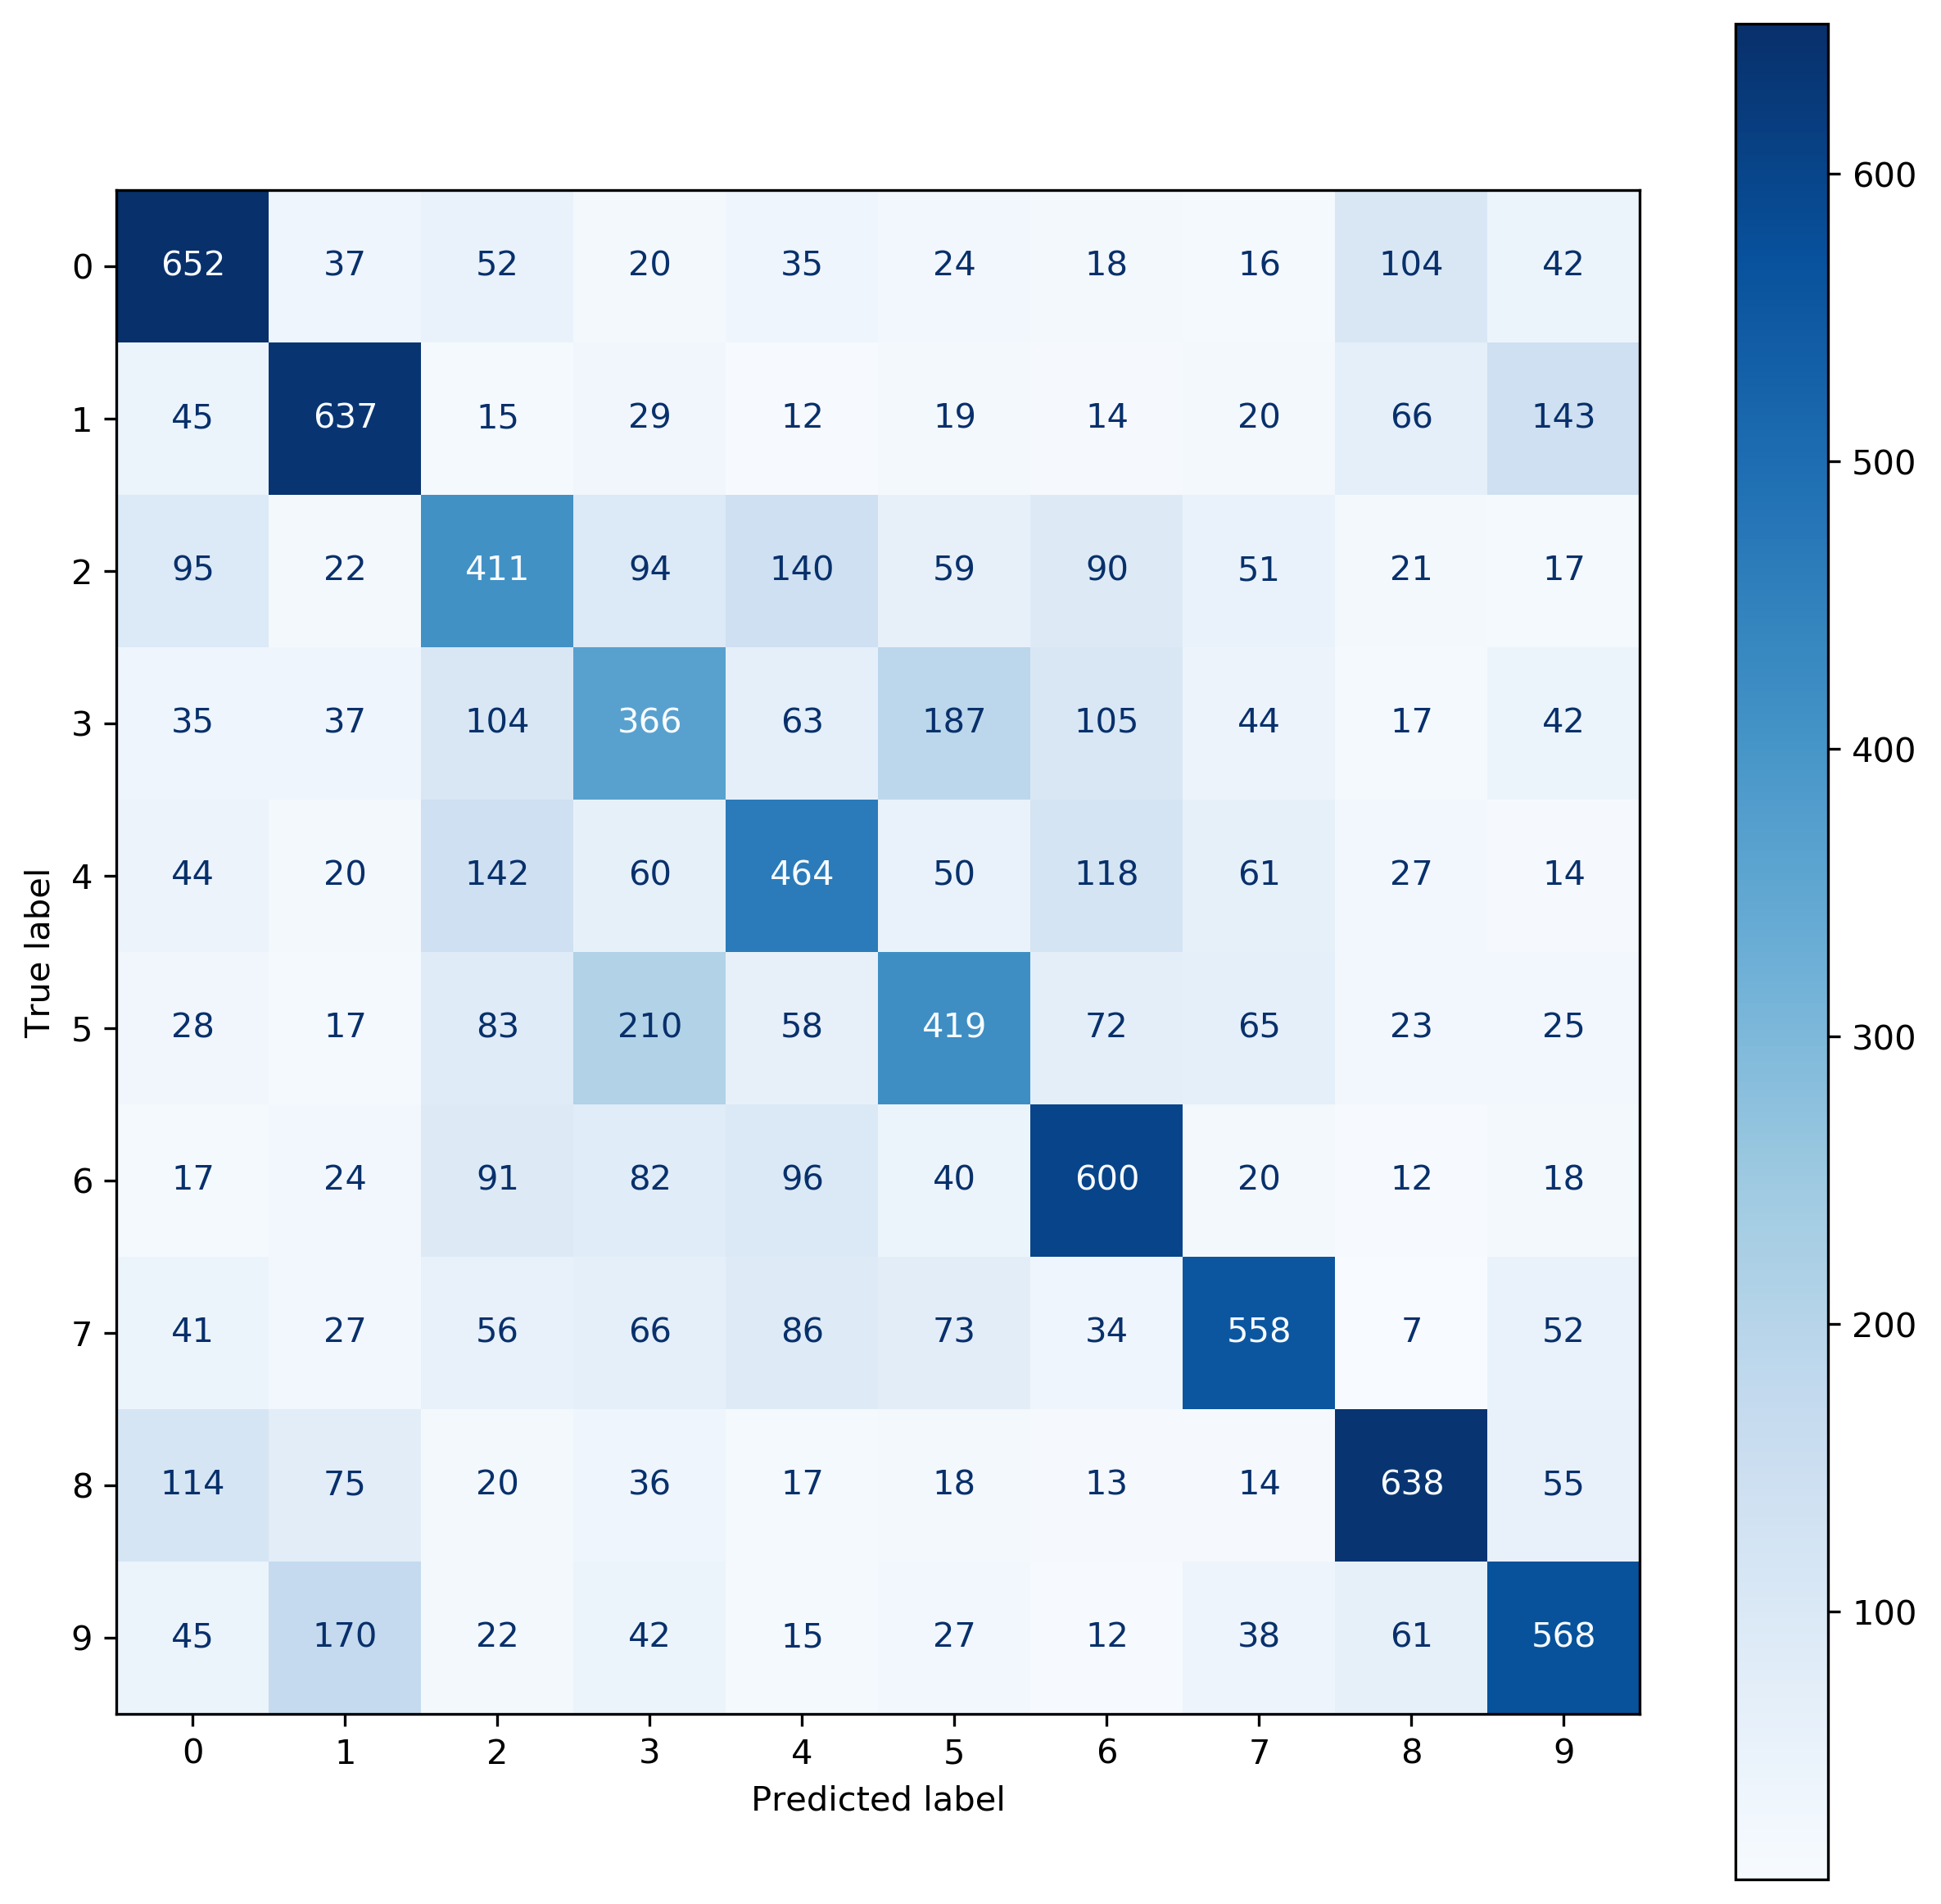
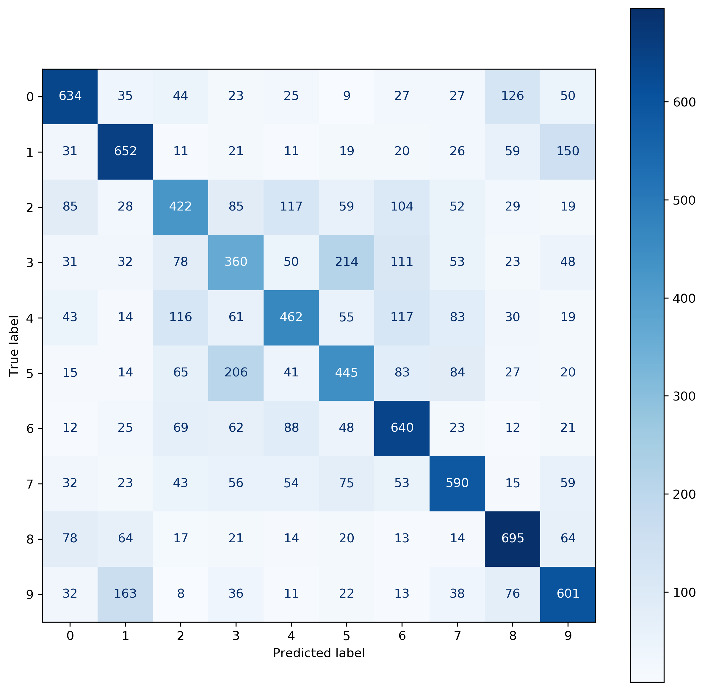
Traditional Methods - Confusion Matrices
SVM
Voting

Slide 10

Histogram of Oriented Gradients(HOG)
Step 1: Preprocess the data: From 32*32 pixels to 64*128 pixels to keep width to height ratio 1:2.
Step 2: Calculating Gradients for both ‘X’ and ‘Y’ directions:
Let the blue pixel at center be our pixel of concern. Gradients, Gx (change in X direction) = X2 – X1 Gy (change in Y direction) = Y2 – Y1
Step 3: Magnitude and Orientations:
Total gradient magnitude = √(Gx)²+(Gy)²
Orientation = atan (Gy / Gx )

Slide 11
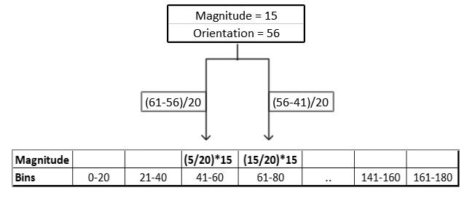
Histogram of Oriented Gradients(HOG)
Step 4: Histogram of Gradients using 8*8 pixels per cell:
We then add the contribution of a pixel’s gradient to the bins on either side of the pixel gradient. The higher contribution is given to the bin value which is closer to the orientation as shown in example below:
Per each 8*8 pixels cell, one histogram. One histogram have 9 bins of orientation. Thus, a (9*1) feature vector is created per each cell.

Slide 12
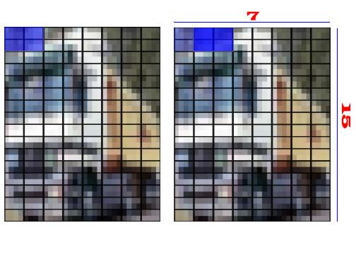
Histogram of Oriented Gradients(HOG)
Step 5: Normalize Gradient using 2*2 cells per block i.e. 1 block of 16*16 pixels:
Gradients are sensitive to overall image lighting variations. To reduce the effect of lighting variation, normalization is done by iterating a block of size 16*16 pixels over the complete image.
One block of 16*16 pixels = 4 cells of 8*8 pixels One block has 4 of (9*1) feature i.e. (36*1) vector of features per block.
Normalization of each block is done by dividing all feature values of a vector by the ‘square root of sum of squares’ of all 36 values.

Slide 13
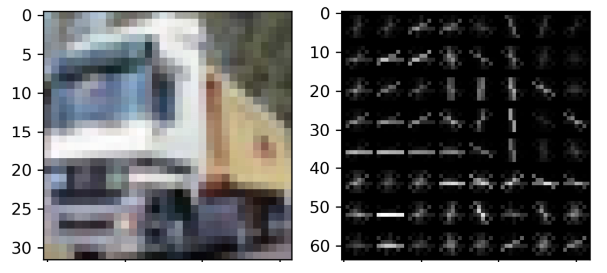
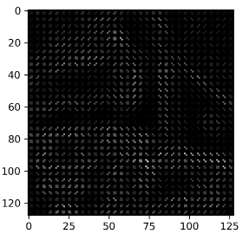
Histogram of Oriented Gradients(HOG)
Step 6: Feature for the complete image:
We would need 7 blocks of 16*16 pixels to cover 64 pixels width and 15 blocks of 16*16 pixels to cover 128 pixels height. Thus, Features for the complete image will be given by 7*15 of (36*1) features which will result in 7*15*36 i.e. (3780*1) vector of features.
Applying HOG feature extraction on CIFAR-10 results: 50000 images in train dataset = feature array of shape (50000*3780) 10000 images in test dataset = feature array of shape (10000*3780).

Slide 14
Traditional Methods (HOG)
Model | Accuracy | Precision | Recall | F1 Score | Time (s)
Naive Bayes | 0.49 | 0.48 | 0.48 | 0.48 | 0.30
KNN | 0.60 | 0.16 | 0.13 | 0.16 | 0.17
Logistic Regression | 0.54 | 0.54 | 0.54 | 0.54 | 31.90
Random Forest | 0.43 | 0.43 | 0.43 | 0.43 | 110.00
Model | Accuracy | Precision | Recall | F1 Score | Time (s)
Naive Bayes | 0.35 | 0.33 | 0.32 | 0.33 | 1.64
Logistic Regression | 0.53 | 0.33 | 0.32 | 0.33 | 171.00

Slide 15
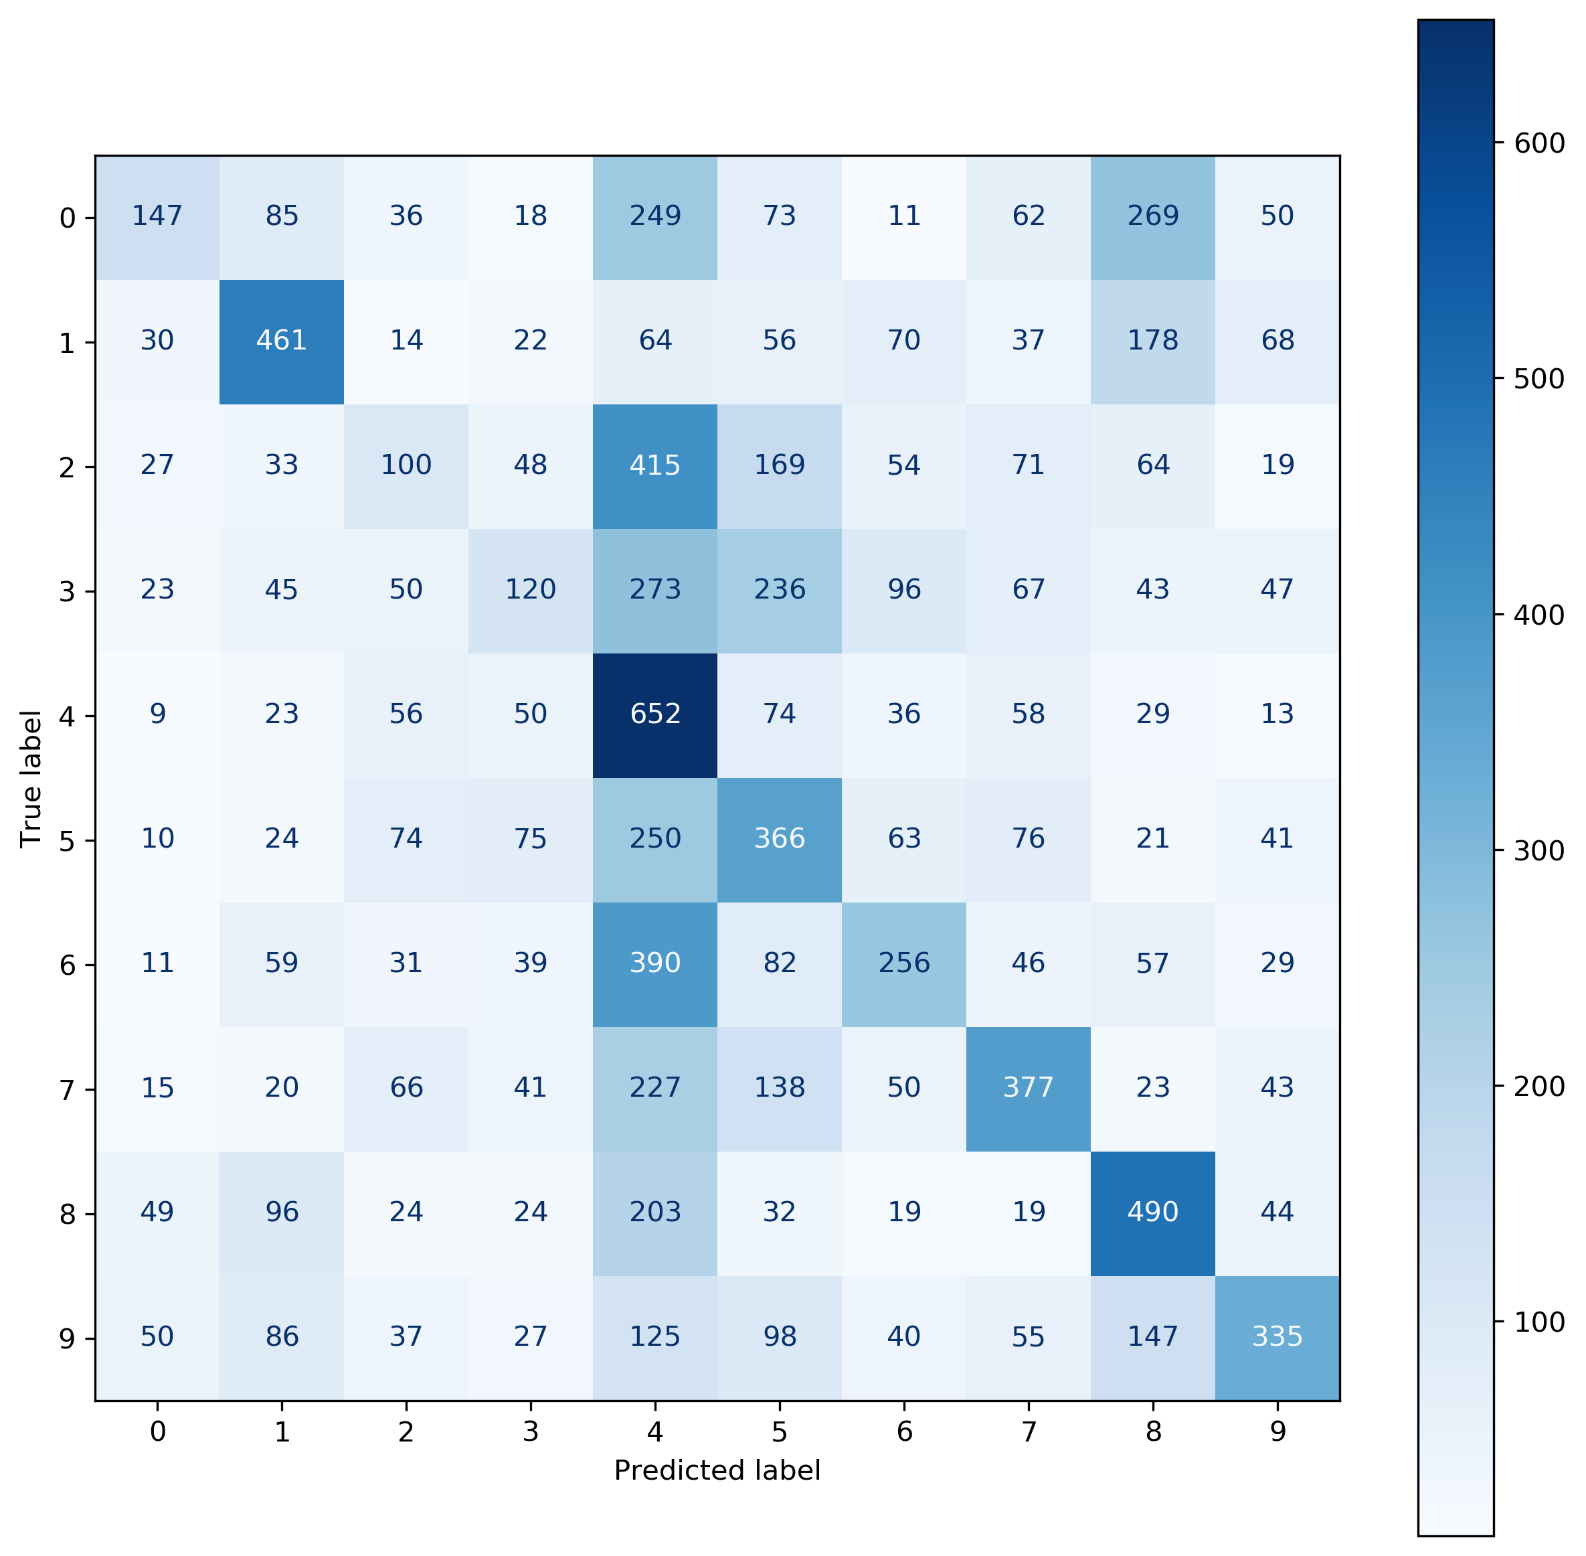
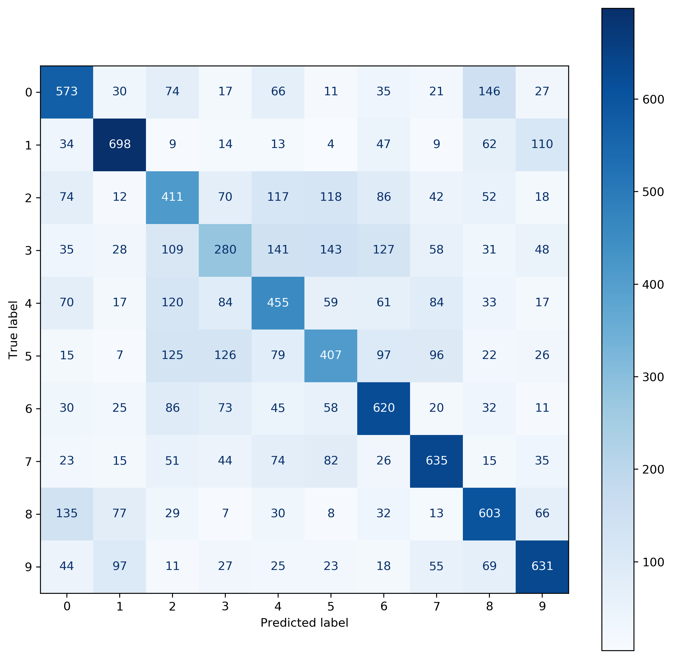
Traditional Methods - Confusion Matrices (HOG)
Naive Bayes
Logistic Regression

Slide 16
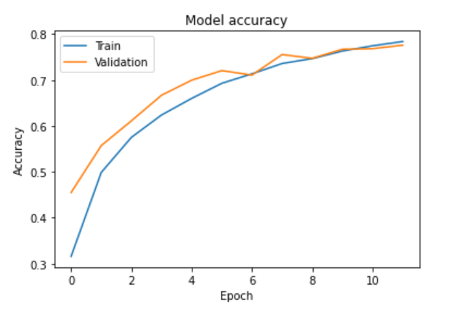
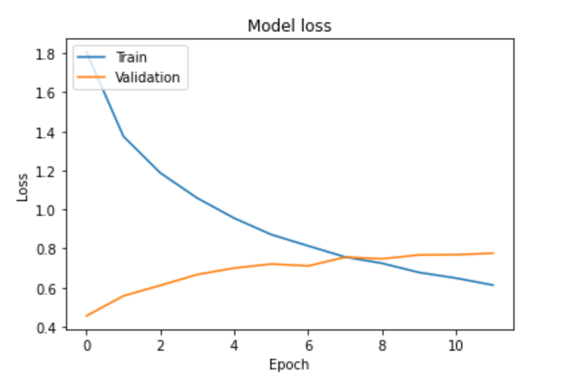
Convolutional Neural Network (CNN)
Adam optimizer and categorical cross entropy loss function was used.
Network was trained on 12 epochs of batch size 128.
3 layer convolutional neural network with relu activation, ‘same’ padding and increasing number of filters (32, 64, 128) was used.

Slide 17
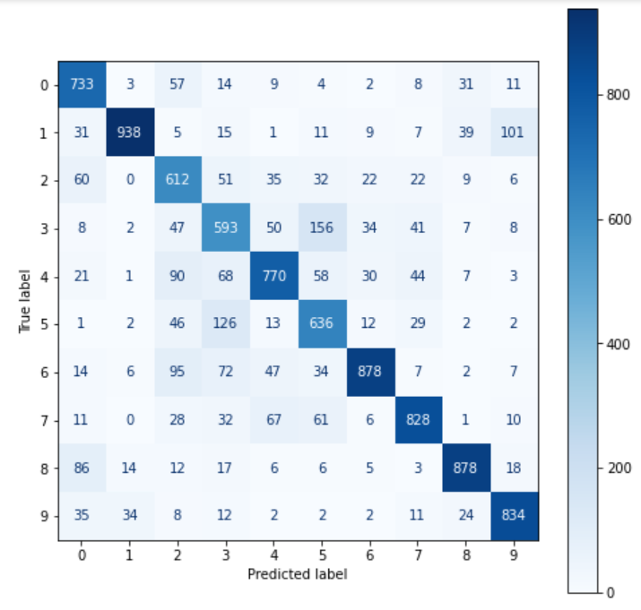
CNN - Metrics & Confusion matrix
Precision | Recall | Accuracy | F1-Score
0.7824 | 0.7804 | 0.7844 | 0.7806

Slide 18
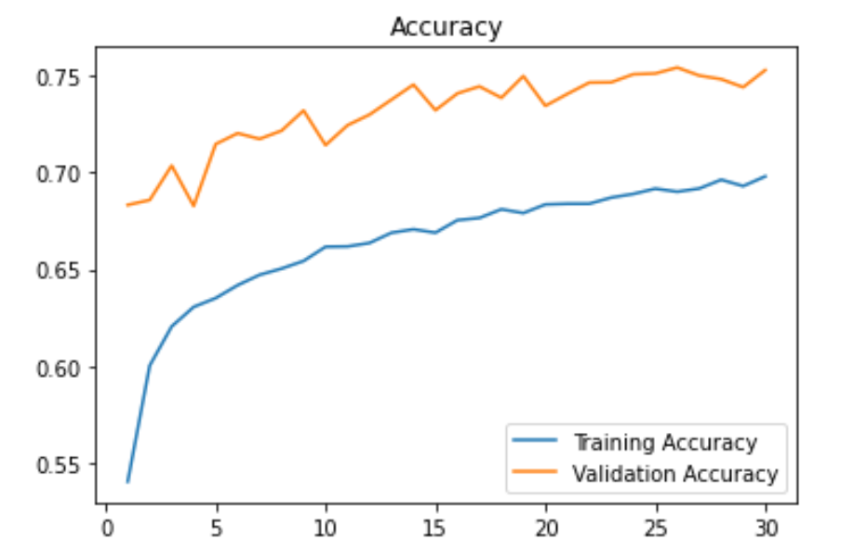
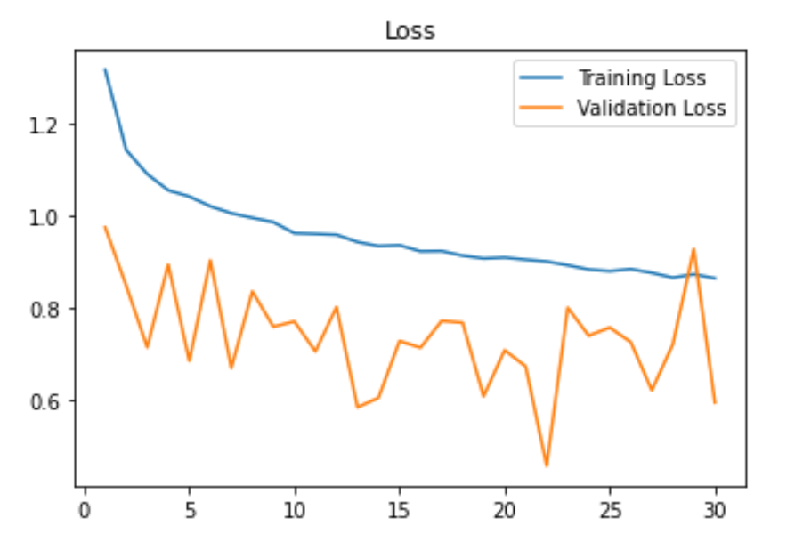
VGG16 – Pre-Trained Neural Network Model
Used Pre-trained 16 layer VGG neural network with 30 epochs and batch size 128. This gave a validation accuracy of 75.27%.
Adam optimizer and categorical cross entropy loss function was used.
The learning and loss curves are shown below

Slide 19
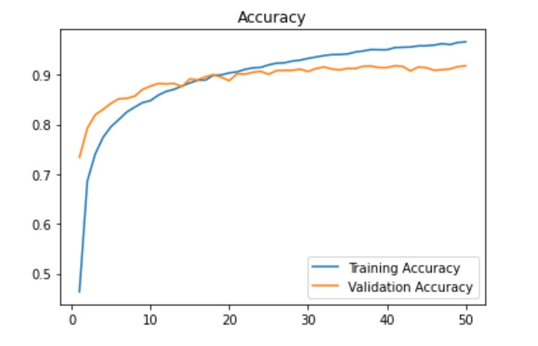
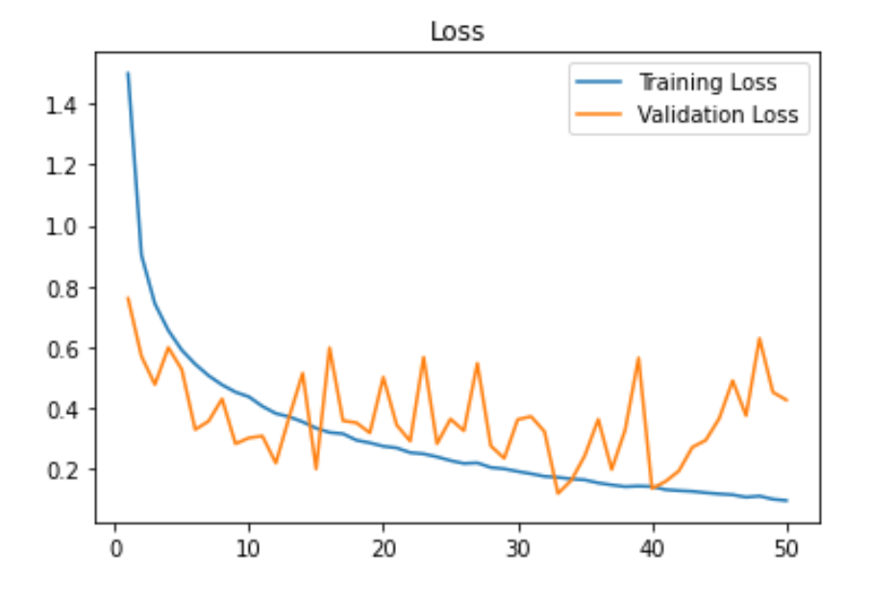
VGG16 – Fine Tuned Model
Fine tuned model by Retraining from Conv-block 4.Trained this on 50 epochs of batch size 128 and obtained validation accuracy of 91.81%.
Adam optimizer and categorical cross entropy loss function was used.
Learning and loss Curves are shown below

Slide 20
VGG16 – Metrics & Time
Model | Precision | Recall | Accuracy | F1-Score | Time | Remarks
Pre-Trained VGG16 | 0.7877 | 0.5677 | 0.7437 | 0.6598 | 4750 | GPU
Fine Tuned VGG16 | 0.9235 | 0.8710 | 0.9186 | 0.8964 | 5000 | GPU

Slide 21
Results – Test data
Model | Training | Validation | Test | Time(s) | Remarks
Voting | 100.0% | 57.85% | 55.0% | 1492 | CPU
CNN | 79.2% | 78.4% | 78.0% | 72 | GPU
VGG16 | 96.6% | 91.8% | 91.9% | 5000 | GPU

Slide 22
Conclusion and Future Work
Traditional machine learning methods are not very good at image classification.
Based on this work, the HOG did not improve the performance of the traditional machine learning methods. However, that problem may be solved by tweaking the settings and parameters if one has the time.
Accurate results using HOG will be more computationally expensive because more features are needed.
Among all algorithms used Fine Tuned VGG16 works the best on image data.
Time complexity of VGG16 is high compared to most of the algorithms used.
We can improve the performance of Neural Networks by Retraining whole VGG16 and using more epochs.

Slide 23
Thank you.
Questions?

